Slide 1
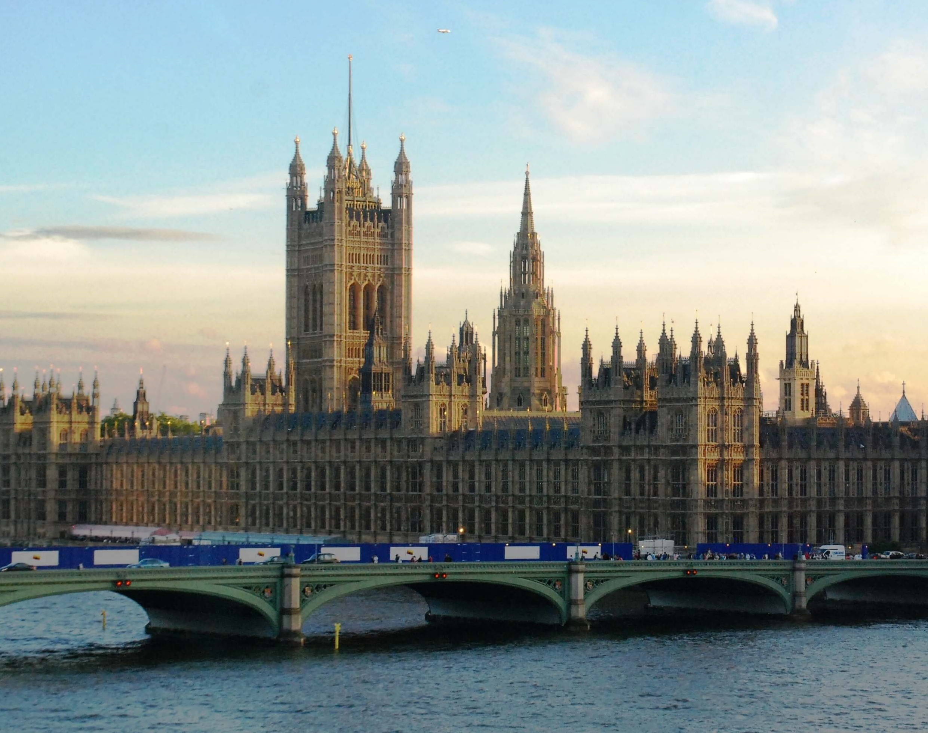
PUBLIC LAW: Lecture 3
PARLIAMENTARY SOVEREIGNTY

Slide 2
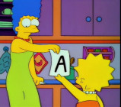
Formative Assessment
Friday, 11 November – No lectures, instead you will undertake your Formative.
Online
Assessment release on LL1001 Moodle page at 5pm on Thursday, 10 November
Submission deadline – 4pm on Friday, 11 November
No late submissions! No extensions!
Submission box on LL1001 Moodle page
Check LL1001 Moodle page ‘Assessments’ section
Compulsory
Feedback

Slide 3
Today’s Plan
Historical development of Parliamentary Sovereignty
The theories behind the doctrine of Parliamentary Sovereignty
Parliamentary Sovereignty Explored
Parliamentary Sovereignty today and tomorrow

Slide 4
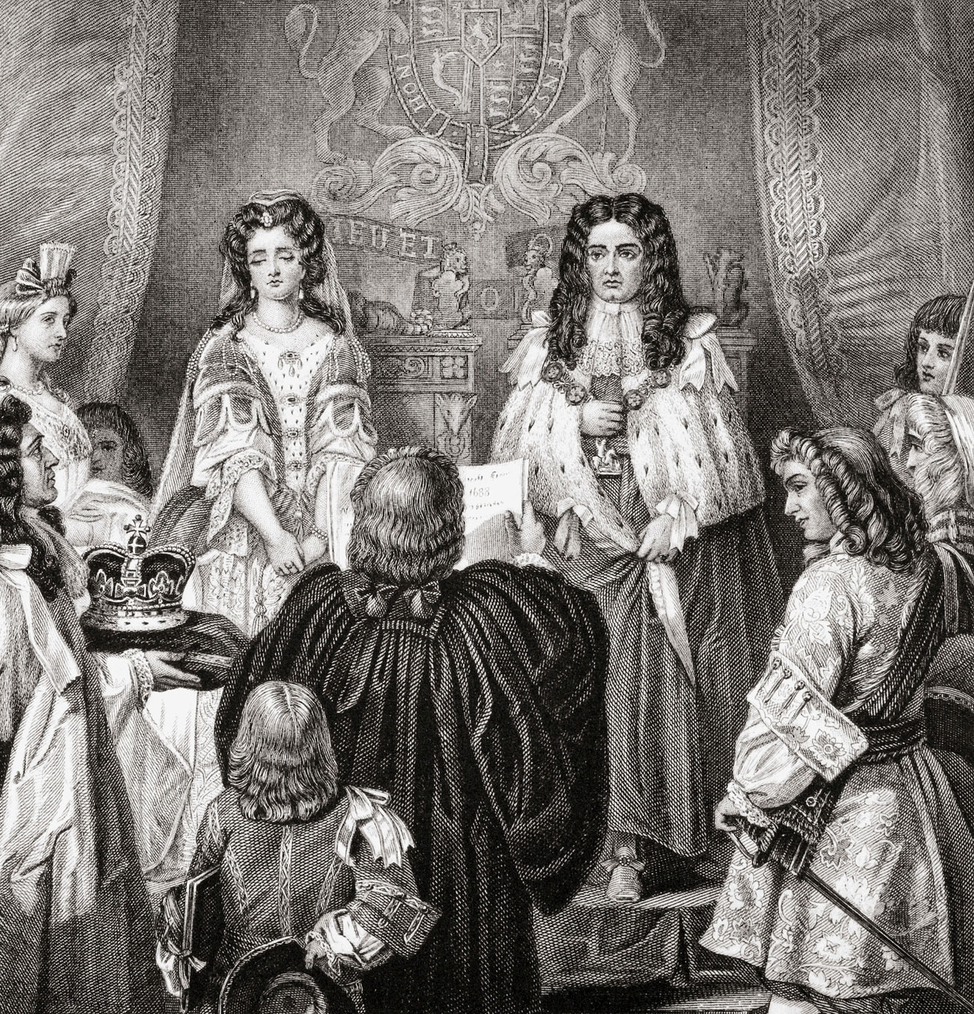
How did Parliament become sovereign?
Pre-1688: doubts over Parliamentary Sovereignty
Dr Bonham’s Case (1610) 8 Co Rep 114 Coke CJ at 118: … when an Act of Parliament is against common right and reason, or repugnant, or impossible to be performed, the common law will control it, and adjudge such an Act to be void.
the Glorious Revolution of 1688 and the Bill of Rights
Article 9: ‘… the freedom of speech and debates or proceedings in Parliament ought not to be impeached or questioned in any court or place out of Parliament’.

Slide 5
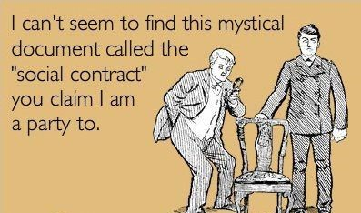
Legal or Political?
Legal [rule of recognition]
Hart in The Concept of Law
R (on the application of Jackson) v Attorney General [2005] UKHL 56
Political
Hobbes, Paine, and Locke – social contract
‘Government is necessary, not because man is naturally bad... but because man is by nature more individualistic than social.’ (Hobbes)

Slide 6
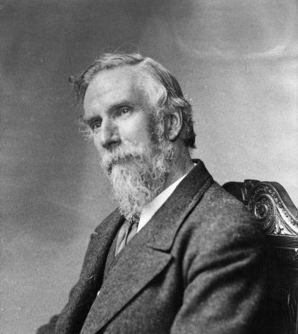
A V Dicey on Parliamentary Sovereignty
‘Introduction to the Study of the Law of the Constitution’ 1885
‘The principle of parliamentary sovereignty means neither more nor less than this, namely, that Parliament … has … the right to make or unmake any law whatsoever and … no person or body is recognised as having the right to override or set aside the legislation of Parliament’
3 principles:
Parliament can make or unmake any law it wants
No body or person can question the validity of an Act of Parliament
No Parliament is bound by its predecessors or can bind its successors

Slide 7
Parliamentary Sovereignty Explored I: Parliament can make or unmake any law it wants.
Simple answer: YES!, but it is more complicated in reality.
Madzimbamuto v Lardner-Burke [1969] 1 AC 645 Lord Reid at 723:
‘It is often said that it would be unconstitutional for the United Kingdom Parliament to do certain things, meaning that the moral, political and other reasons against doing them are so strong that most people would regard it as highly improper if Parliament did these things. But that does not mean that it is beyond the power of Parliament to do such things. If Parliament chose to do any of them the courts could not hold the Act of Parliament invalid.’
Retrospectivity
War Damages Act 1965 & Burmah Oil v Lord Advocate [1965] AC 75
Extra-territorial laws
War Crimes Act 1991 & Criminal Justice and Immigration Act 2008
British Coal Corporation v R [1935] AC 500: ‘It is doubtless true that the power of the Imperial Parliament to pass on its own initiative any legislation it thought fit extending to Canada remains in theory unimpaired’

Slide 8
Parliamentary Sovereignty Explored II: No body or person can question the validity of an Act of Parliament.
Manuel v Attorney General [1983] Ch 77 Sir Robert Megarry VC at 86: … [There is] nothing in this case to make me doubt the simple rule that the duty of the court is to obey and apply every Act of Parliament, and that the court cannot hold any such Act to be ultra vires. Of course there may be questions about what the Act means, and of course there is power to hold statutory instruments and other subordinate legislation ultra vires. But once an instrument is recognised as being an Act of Parliament, no English court can refuse to obey it or question its validity.

Slide 9
Parliamentary Sovereignty Explored II continued: No body or person can question the validity of an Act of Parliament.
What is a valid Act of Parliament? – the enrolled Bill rule
Lord Campbell in Edinburgh and Dalkeith Ry. Co. v. Wauchope [1842] UKHL 710: All that a Court of Justice can do is to look to the Parliamentary roll: if from that it should appear that a bill has passed both Houses and received the Royal assent, no Court of Justice can inquire into the mode in which it was introduced into Parliament, nor into what was done previous to its introduction or what passed in Parliament during its progress in its various stages through both Houses.
Judicial reluctance to intervene – refer back to Manuel v Attorney General [1983] Ch 77
Pickin v British Railways Board [1974] AC 765 Lord Reid at 787: The function of the court is to construe and apply the enactments of Parliament. The court has no concern with the manner in which parliament or its officers carry out its standing orders.
Contradiction with international law
Cheney v Conn [1968] 1 All ER 779

Slide 10
Parliamentary Sovereignty Explored III: No Parliament is bound by its predecessors or can bind its successors.
Simple logic: Ensuring the continued sovereignty of the Parliament.
Express repeal – self explanatory
section 211(2) and Schedule 27 to the Equality Act 2010
Implied repeal
Rule for the courts
Strong judicial support: Ellen Street Estates Ltd v Minister of Health [1934] 1 K.B. 590
‘If in a subsequent Act Parliament chooses to make it plain that the earlier statute is being to some extent repealed, effect must be given to that intention just because it is the will of the legislature.’

Slide 11

Challenges to Parliamentary Sovereignty: Entrenchment
Entrenchment – ex: a specified majority of the legislature or a referendum
Manner and form
Attorney General for New South Wales v Trethowan (1932)
Minister of the Interior v Harris (1952)
Jackson v AG [2005] UKHL 56 and the Parliament Acts 1911 and 1949 – “a new method of passing legislation”

Slide 12

Challenges to Parliamentary Sovereignty?: Constitutional Statutes and Implied Repeal
Thoburn v Sunderland City Council [2002] EWHC Admin 195, [62]-[63] per Laws LJ “in my opinion a constitutional statute is one which:
(a) conditions the legal relationship between citizen and State in some general, overarching manner, or
(b) enlarges or diminishes the scope of what we would now regard as fundamental constitutional rights”
R (HS2 Action Alliance Ltd) v Secretary of State for Transport [2014] UKSC 3
Miller 1
Petition of Right 1628, Bill of Rights 1689, Act of Settlement 1701, Act of Union 1707, Treaty of Union with Ireland Act 1800, Representation of the People Acts 1832–84, European communities Act 1972, Human Rights Act 1998, Scotland Act 1998, Northern Ireland Act 1998, Constitutional Reform Act 2005, Government of Wales Act 2006

Slide 13
Constitutional statutes after HS2 and Miller 1
A ‘fundamental statute’, e.g. Bill of Rights 1689, is immune from implied repeal and will prevail in a clash with a constitutional statute
A Constitutional Statute, e.g. Human Rights Act 1998, is immune from implied repeal and will prevail in a clash with a normal statute.
A normal statute, e.g. Theft Act 1957, is not immune from implied repeal

Slide 14

Challenges to Parliamentary Sovereignty?: The EU Membership
Joining the EU
European Communities Act 1972
s2(4) “any enactment, passed or to be passed … shall be construed and have effect subject to the foregoing provisions of this section”
s3 English courts must follow decisions of the CJEU
Referendum 05/06/1975 67.2% in favour
Costa v ENEL [1964] CMLR 425
R v Secretary of State ex parte Factortame (No 2) (1991) 1 AC 603
Acts of Parliament may be ‘disapplied’ where conflict
“a constitutional revolution” (Wade)
Jackson v AG [2005] UKHL 56
“The doctrine of the supremacy of Community law restricts the absolute authority of Parliament to legislate as it wants … “
“Parliament has … for the time being … limited its own powers by the European Communities Act 1972”
Leaving the EU
Article 50 Treaty on European Union 1992
“Any Member State may decide to withdraw from the Union in accordance with its own constitutional requirements.”
Referendum 23/06/16 51.9% in favour
R (HS2 Action Alliance Ltd) v Secretary of State for Transport [2014] at [79], [203]-[205]
EU law part of UK law only by virtue of provisions of UK law itself
Miller 1
only Parliament could remove rights created by Acts of Parliament
government (the executive) cannot trigger Article 50
EU Withdrawal Act 2018 - repeals ECA
EU Withdrawal Agreement Act 2020 - transition period

Slide 15
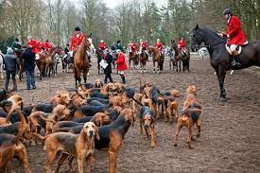
Challenges to Parliamentary Sovereignty?: Rivals?
Jackson v AG [2005] UKHL 56
Lord Hope [103]-[107]
“Our constitution is dominated by the sovereignty of Parliament. But Parliamentary sovereignty is no longer, if it ever was, absolute. It is no longer right to say that its freedom to legislate admits of no qualification whatever … Step by step, gradually but surely, the English principle of the absolute legislative sovereignty of Parliament which Dicey derived from Coke and Blackstone is being qualified … the rule of law enforced by the courts is the ultimate controlling factor on which our constitution is based.”
Lord Steyn [102]
“The doctrine of the supremacy of Parliament, pure and absolute as it was, can now be seen to be out of place in the modern United Kingdom. Nevertheless, the supremacy of Parliament is still the general principle of our constitution. It is a construct of the common law. The judges created this principle. If that is so, it is not unthinkable that circumstances could arise where the courts may have to qualify a principle established on a different hypothesis of constitutionalism.”

Slide 16
Summary
Parliamentary sovereignty as a concept since the Bill of Rights 1689
A V Dicey established three principles for Parliamentary Sovereignty.
In reality, there are restrictions and challenges that Parliament faces.

Slide 17


